Slide 1
Discovery in large, complex data sets
Kiri Wagstaff
kiri.wagstaff@jpl.nasa.gov
Machine Learning and Instrument Autonomy

Slide 2
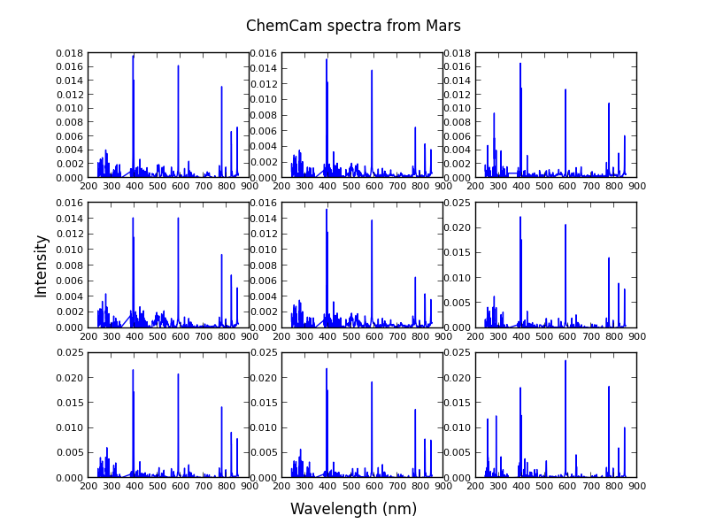
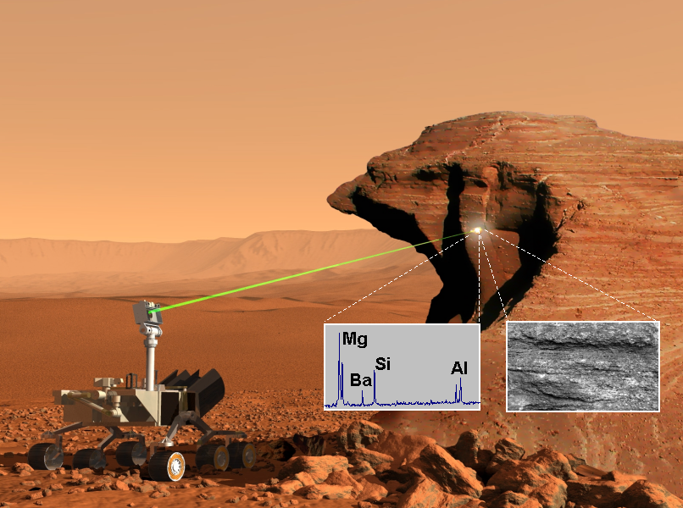
Scientific discovery in large data sets
How to find “interesting” items?
Ca
Na
O
ChemCam spectrometer on Mars Science Laboratory rover
K. Wagstaff, N. Lanza, R. Wiens

Slide 3
Scientific discovery in large data sets
Can “interesting” items be selected for a user in a purely unsupervised way?
Items that differ from previously seen
DEMUD iterative solution:
Build an SVD model of selected/seen items X, not the entire data set D (model what the human knows)
Select new items that are difficult to represent with the model
Update model with each selection
Provides a fast, diverse traversal of the data set
Tells you what is interesting and why
Select
Present
K. Wagstaff, J. Bedell, D. Thompson, T. Dietterich

Slide 4
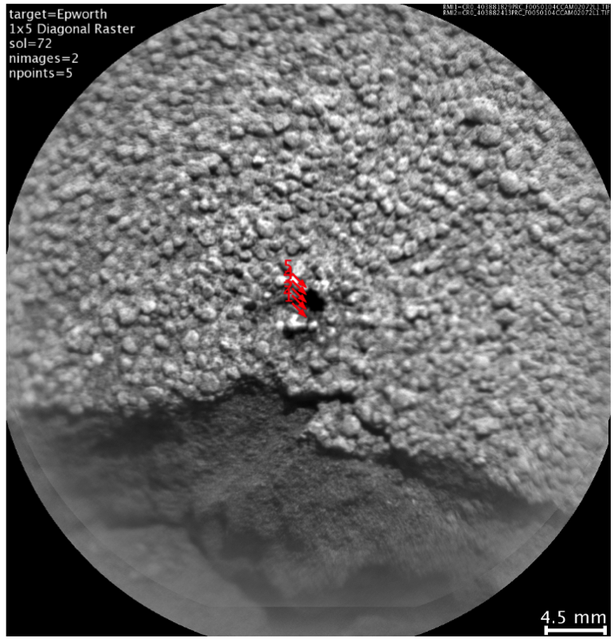
Detection of CaF in ChemCam data
DEMUD flagged a sample from the target Epworth as interesting and pointed to the 600-nm feature (Wagstaff et al., 2014). This discovery was simultaneously published by Forni et al. (2014) as the first discovery of fluorine (CaF) on Mars.
K. Wagstaff, N. Lanza, R. Wiens

Slide 5
DEMUD strengths
Handles high-dimensional data
Very efficient; suitable for large data sets
Provides explanations for selections (“why this is interesting”)
Learns/adapts over time: selects novel observations

Slide 6
Additional Slides

Slide 7
DEMUD excels at class discovery
All 6 classes discovered after 8 selections

Slide 8
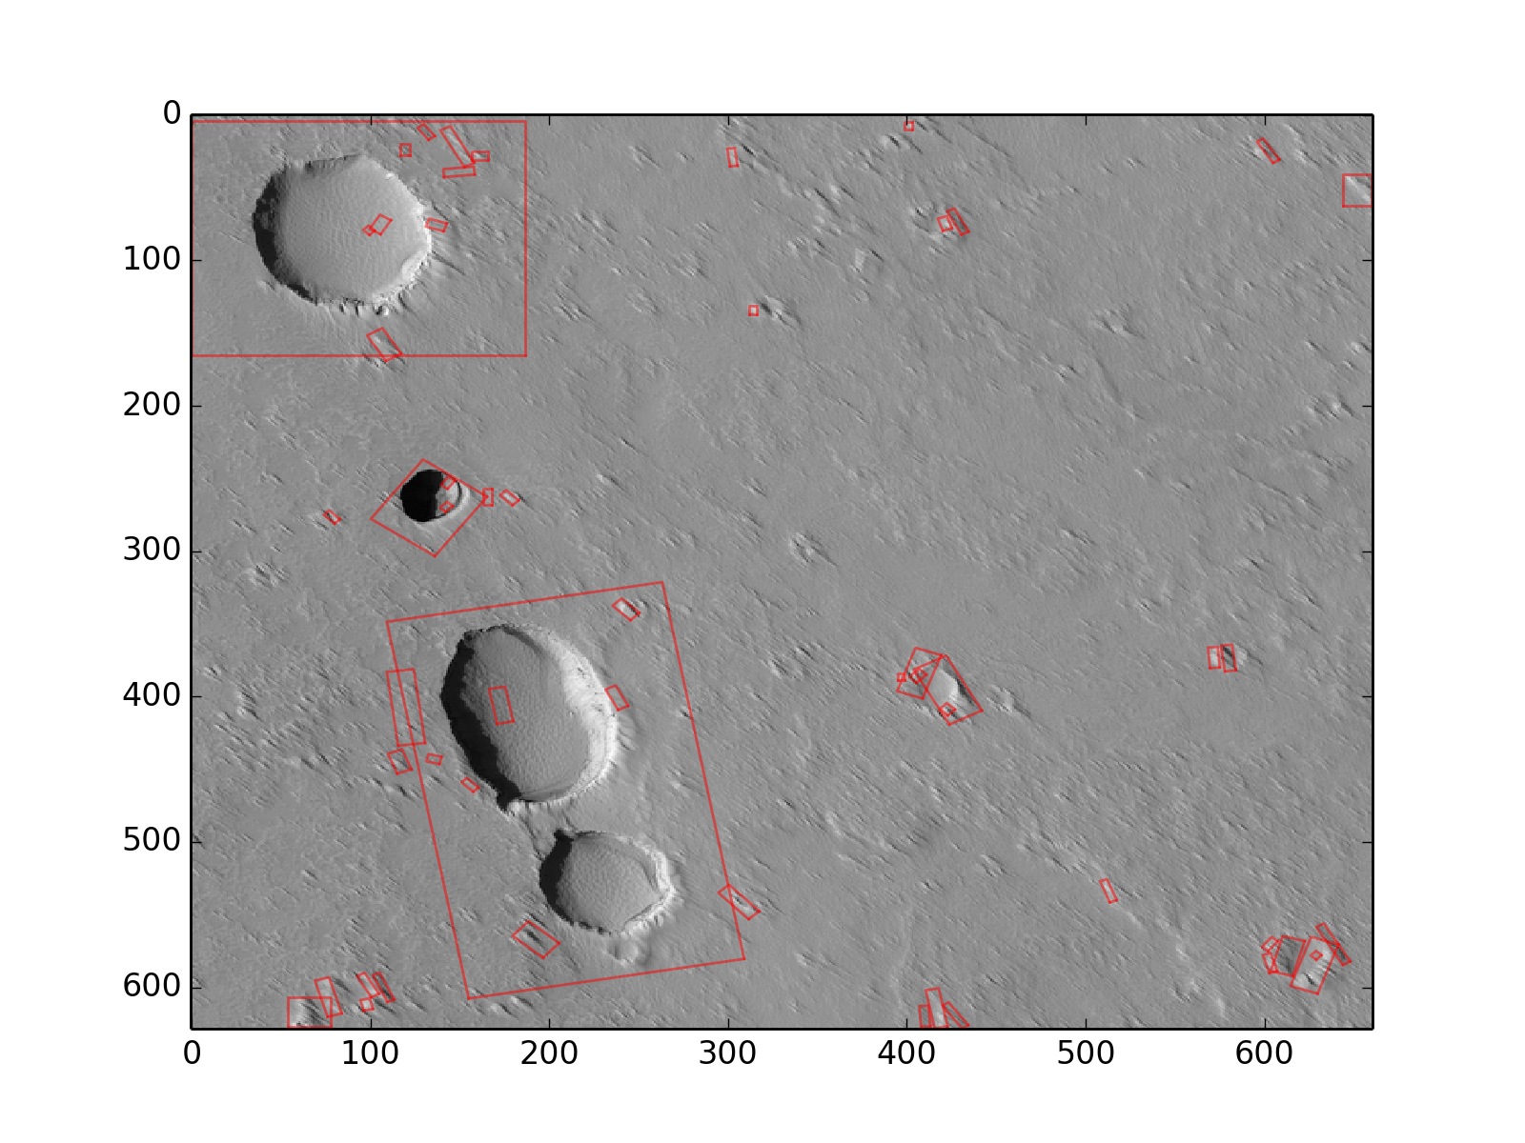
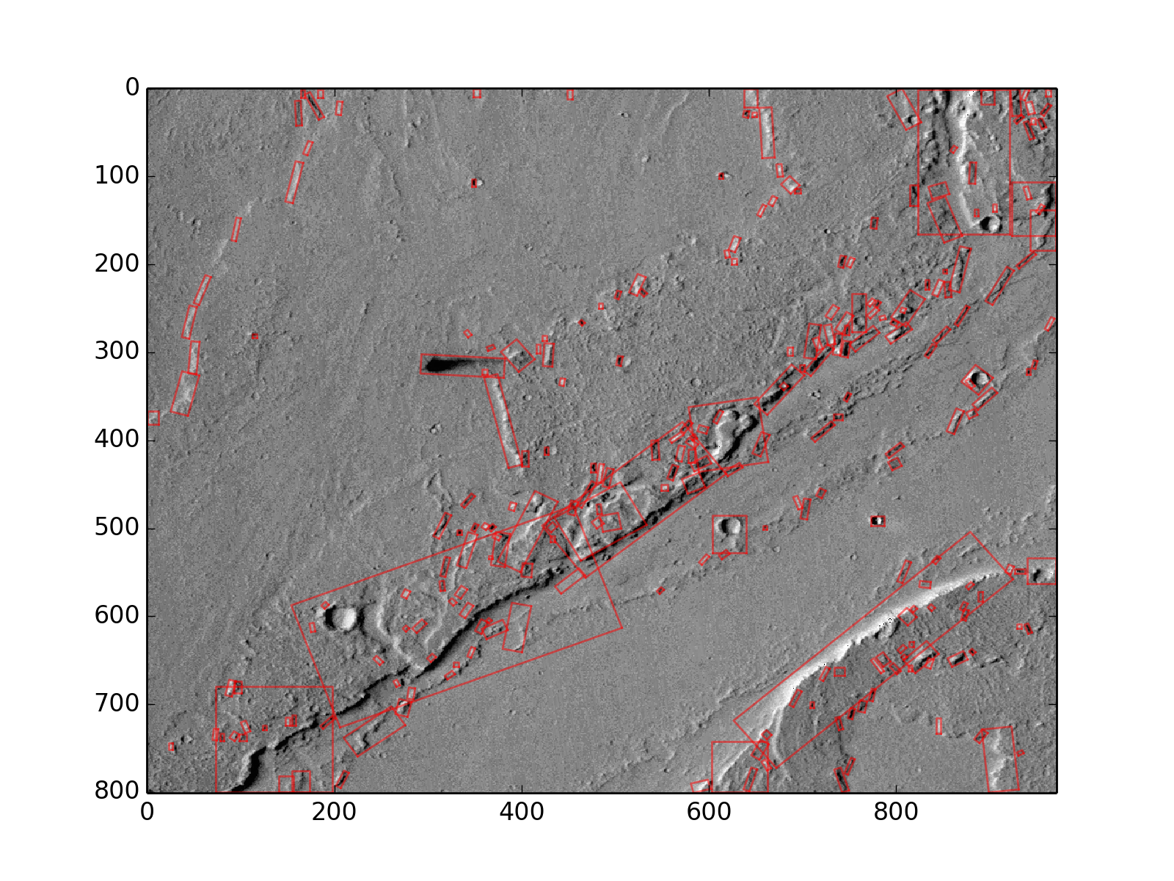
Detection of surface features on Mars
Automated analysis of orbital images
Detect “landmarks”: areas of high visual interest
Classify landmarks by type
Fresh impact crater
Crater
Dune
Mountain
Slope streak
Fresh Impact crater
K. Wagstaff, B. Bornstein, R. Kiran, L. Mandrake, A. Smith, N. Schorghofer
Image-Based Change Detection
Instrument Operations Technology - 8

